Slide 1
Dynamic Analysis of 3-DOF Planar Robotic Arm
MEGHDEEP JANA 150103082 ROHAN AGARWAL 150103058 SUHAS MASANA 150103070

Slide 2
Contents
Objective
Introduction
Trajectory of motion
Physical Model
Finite Element Analyisis
Mathematical Model
Joint Parameters
Results
Conclusion
References

Slide 3
Objective
Understanding the application of robotic arm in IR Physiotherapy.
Deriving equation of trajectory for the above application.
Assuming links and joint physical properties and making a physical model.
Finite element analysis to check if the assumed parameters maintain a factor of safety.
Deriving the equation of motion.
Result analysis.

Slide 4
Introduction
A robotic arm is a type of mechanical arm, usually programmable, with similar functions to a human arm. The links of such a manipulator are connected by joints allowing either rotational motion (such as in an articulated robot) or translational (linear) displacement.
A robot manipulator is constructed using rigid links connected by joints with one fixed end and one free end to perform a given task. The joints to this robotic manipulator are the movable components, which enables relative motion between the adjoining links.
We have to analyse a robotic arm with application in physiotherapy for automating IR Therapy.

Slide 5

Introduction
For the application of IR physiotherapy we have taken a 3 DOF robotic arm.
2 DOF to make the IR Emitter reach the target spot, and the 3rd DOF to keep the IR Emitter in a particular constant orientation with respect to the target spot.
The trajectory of motion that we will be using for our End-effector ( IR Emitter) is a circular trajectory.
The RPM for it is taken to be 15 RPM.

Slide 6
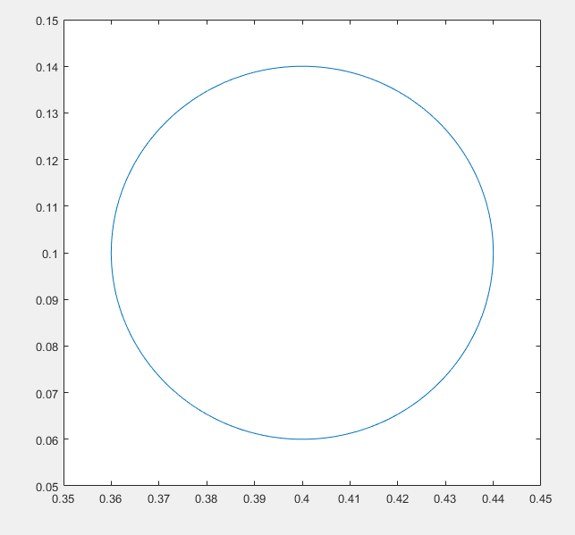
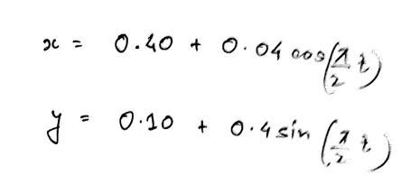
Trajectory of motion
Trajectory has been defined as a circle for the given application.
equation for circle is:
taking joint 1 as the origin

Slide 7
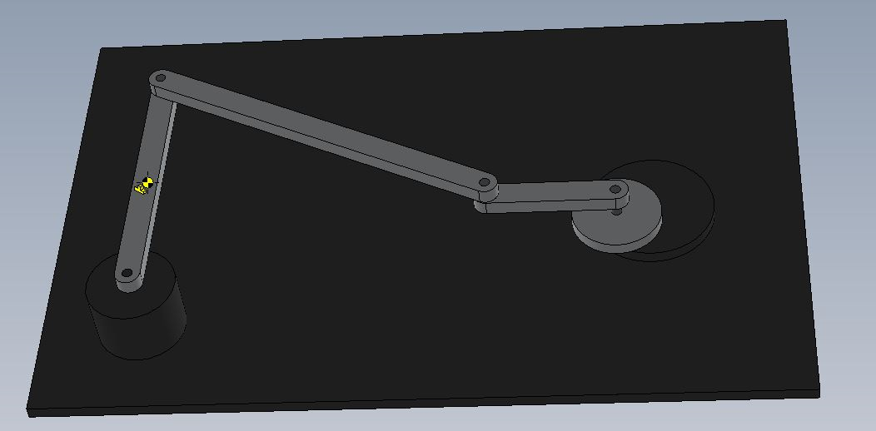
Physical Model - Solidworks

Slide 8
Physical Model
Link lengths were assumed keeping in mind the average human arm lengths.
Link breadth and thickness were also assumed.
Solidworks model was made using the assumed parameters.
Material of links were taken as 1060 Aluminium alloy because of its light weight and durability compromise.
Further, FEA was done to check if the stresses are exceeding the limits.

Slide 9
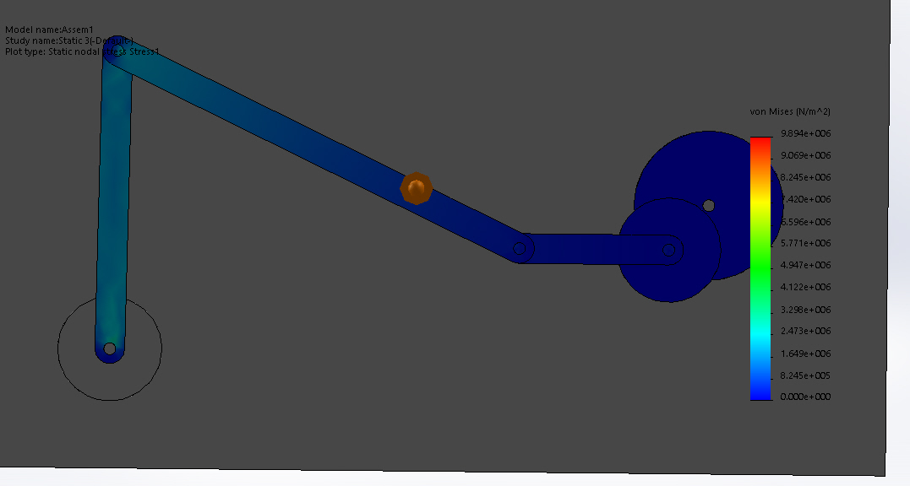
Static FEA

Slide 10
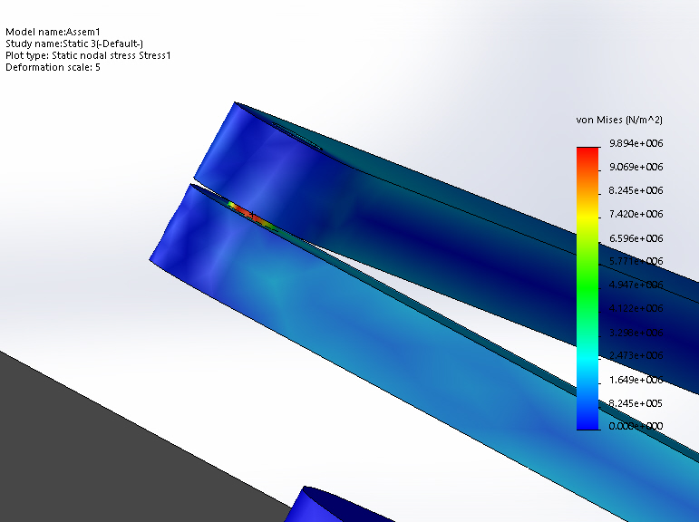
Static FEA

Slide 11
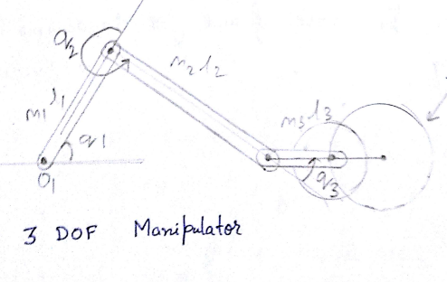
Finding Joint Angles
Using the equation of trajectory, x and y co-ordinates of the trajectory in time steps of 0.01 secs was found.
Using relation of joint angles with x,y the joint angles were found in time steps of 0.01secs.
Link 3 is taken parallel to be x-axis.
The joint angular velocities and angular acceleration were found using MATLAB’s inbuilt function diff.

Slide 12
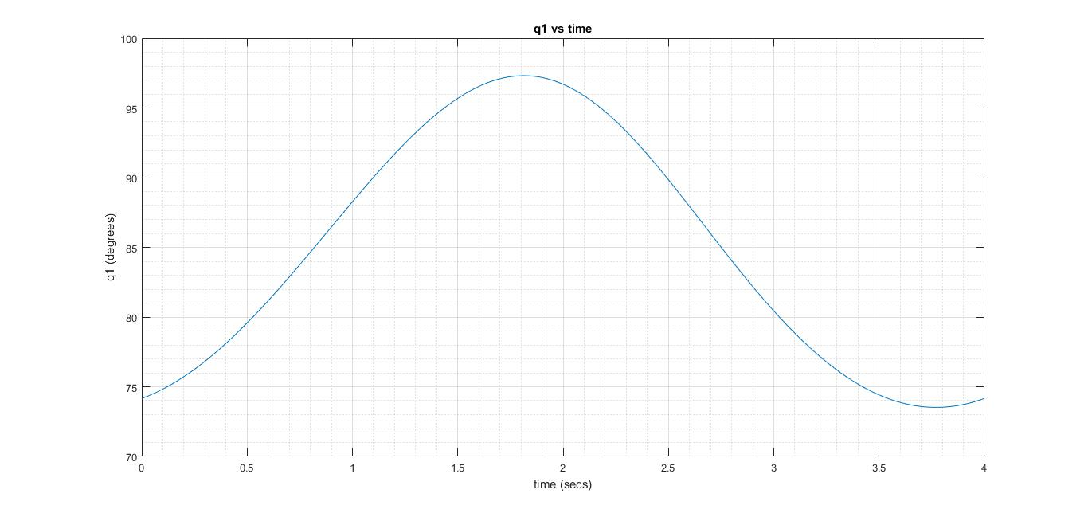
Joint Angles - q1

Slide 13
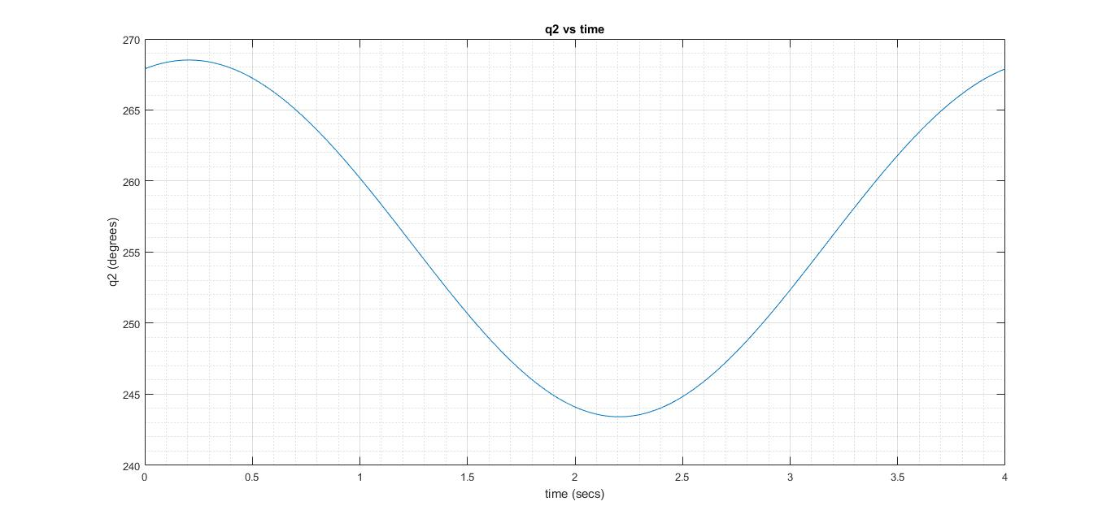
Joint Angles - q2

Slide 14
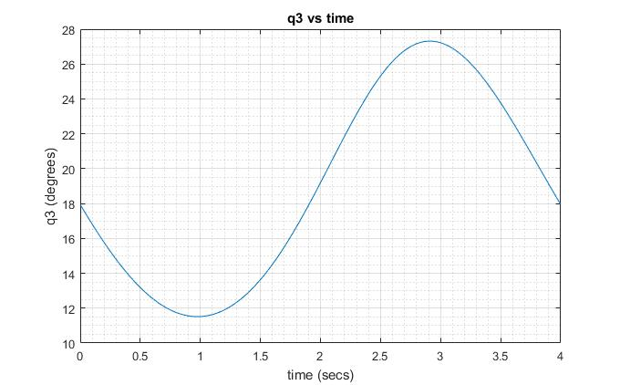
Joint Angles - q3

Slide 15
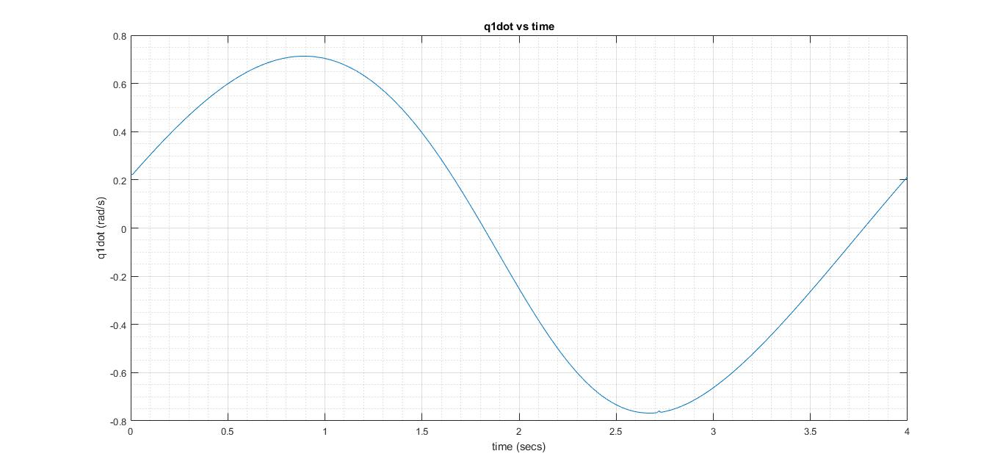
Joint Angular Speed - q1dot

Slide 16
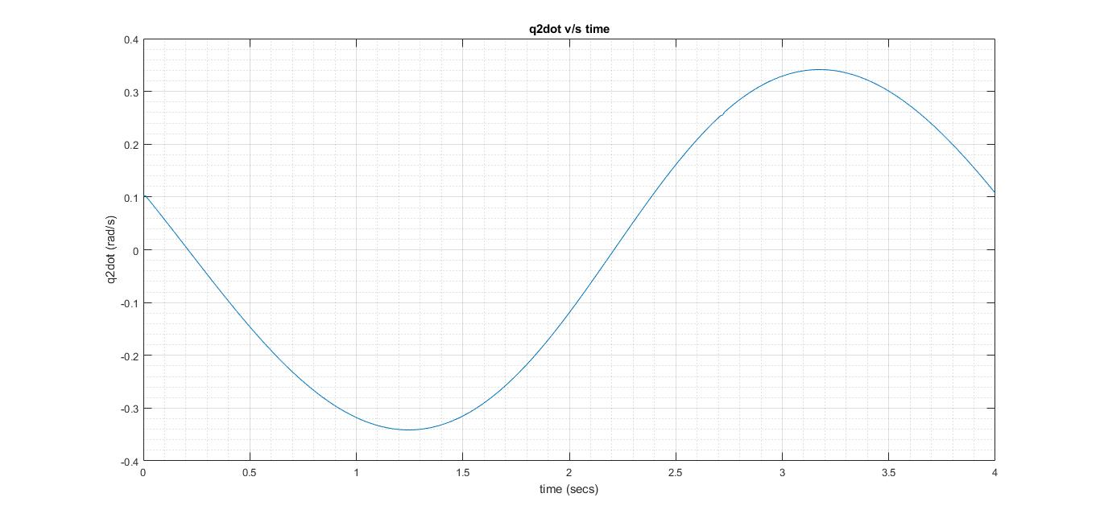
Joint Angular Speed - q2dot

Slide 17
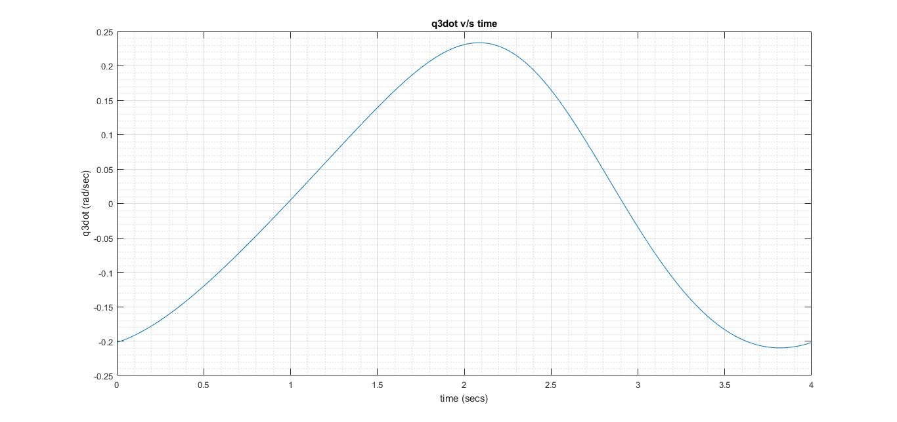
Joint Angular Speed - q3dot

Slide 18
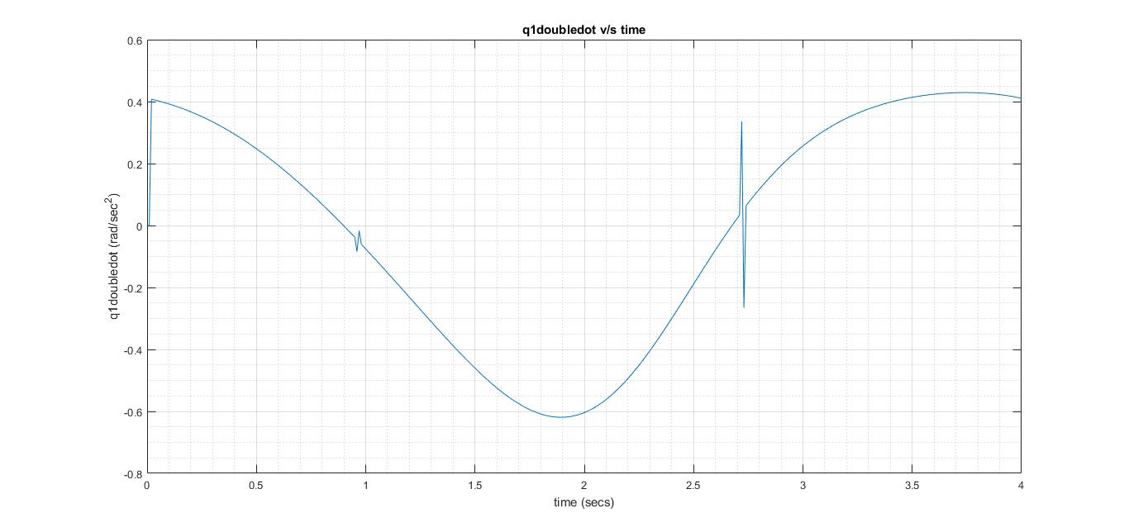
Joint Angular Acceleration - q1doubledot

Slide 19
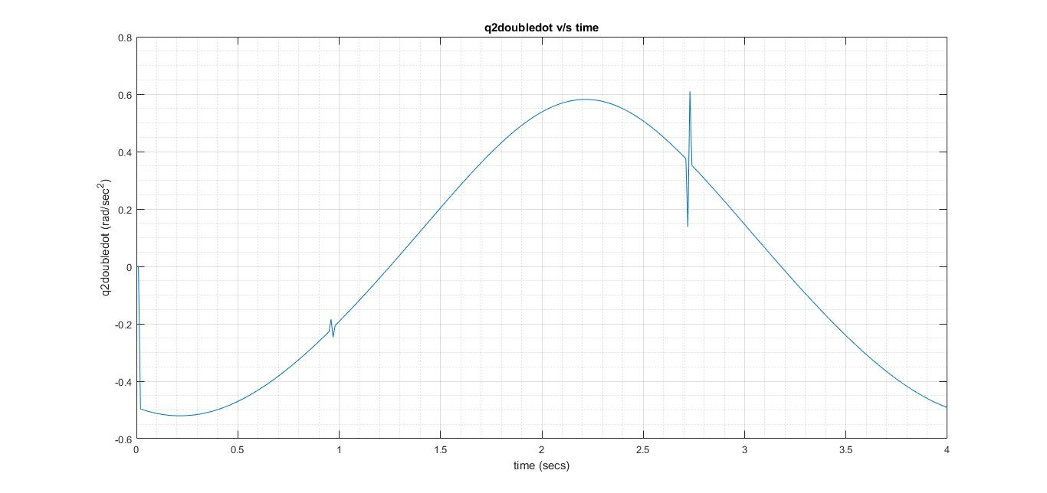
Joint Angular Acceleration - q2doubledot

Slide 20
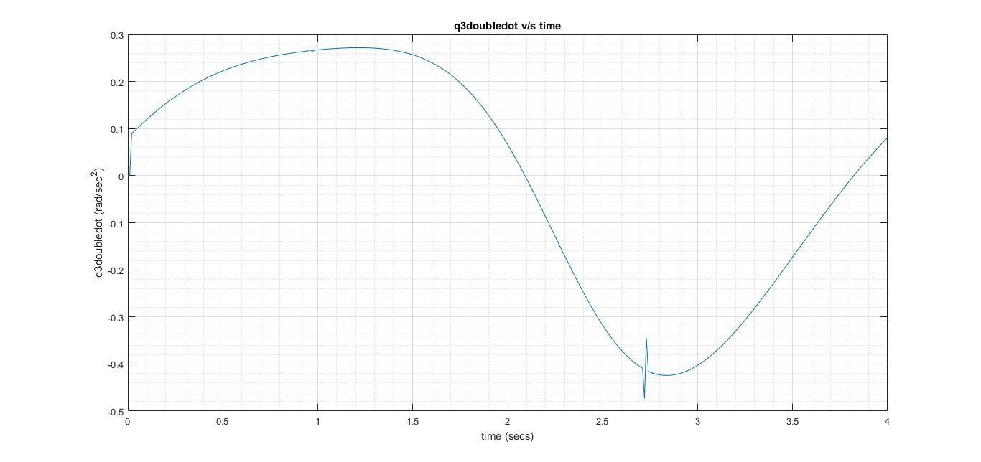
Joint Angular Acceleration - q3doubledot

Slide 21
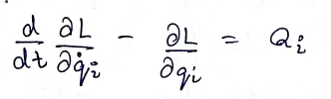
Mathematical Model
Euler-Lagrange equation was used to derive the equation of motion of the 3DOF planar arm.
Only interactive inertia torque, centrifugual and coriolis torque contribute to equation of motion.
Potential Energy has no change with joint parameters as:
Links are rigid.
Links move in one plane.

Slide 22
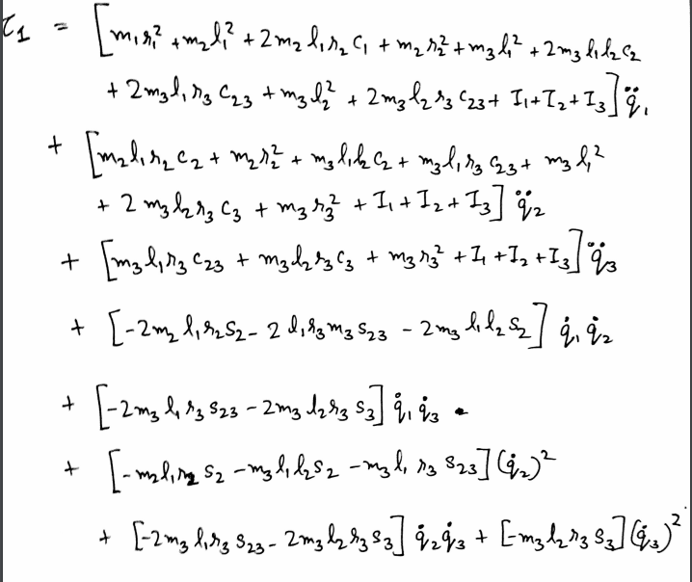
Equation of motion
Equation of motion was derived to be, for motor 1 torque:

Slide 23
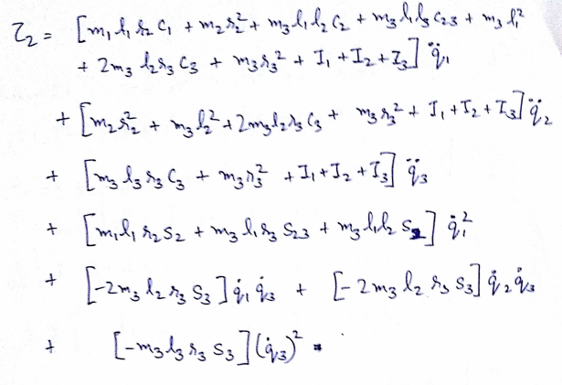
Equation of motion
For Motor 2 torque:

Slide 24
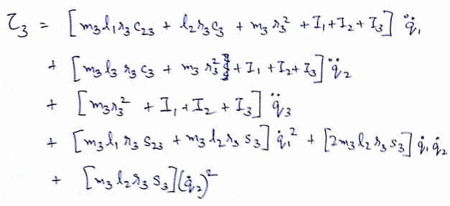
Equation of motion
For Motor 3 torque:

Slide 25
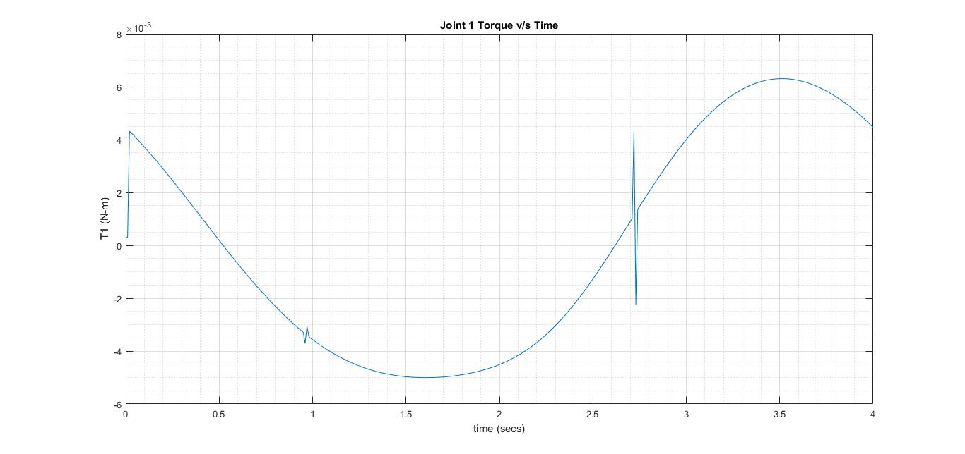
Output Torques - T1
Using equation of motion, the Torque Curves were found to be:

Slide 26
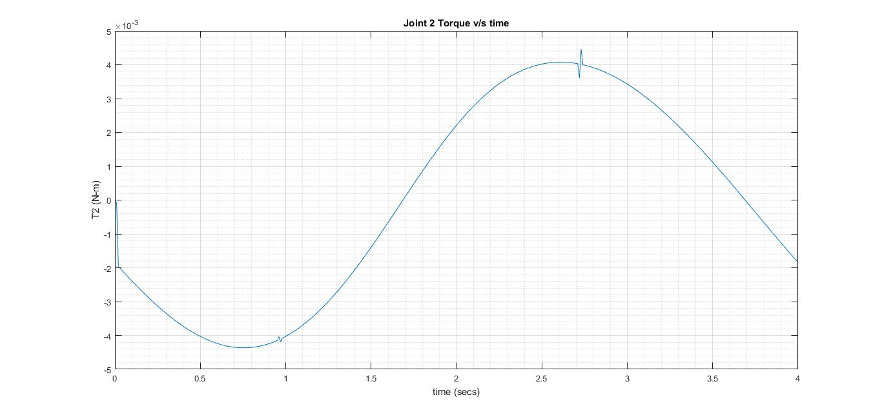
Output Torques - T2

Slide 27
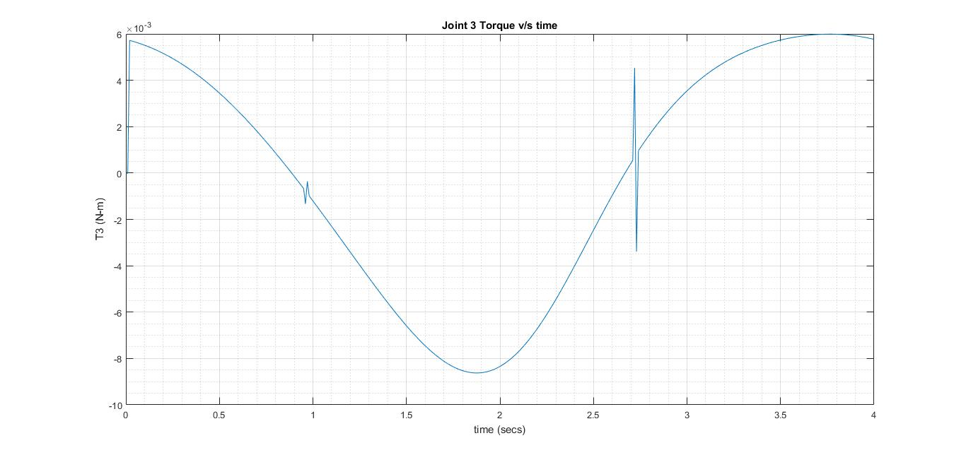
Output Torques - T3

Slide 28
Result Analysis
From FEA
The stresses in static loading condition (own weight) were found to be in feasible range.
Highest stress concentration were found at joint pins.
From Mathematical Modelling
Torque parameters were found and can be used to actuate the motion of the motors at each joint.
The spike in the graph has arrived due to approximation error in MATLAB’s inbuilt function fsolve while finding joint angles q1, q2 and q3 and later amplified this spike due to approximation error in MATLAB’s inbuilt function diff.

Slide 29
Conclusion
The equation of trajectory was taken as circular trajectory for the given application.
Physical Modelling and FEA was done to ensure that the assumed link properties are within material limits.
Joint angles and other parameters were found by using trajectory equation and geometry.
Equation of motion was derived using Euler-Lagrange Equation.
Torque curves were obtained by putting the values of joint parameters into the equation of motion.
Results were plotted and analysed.

Slide 30
References
Jolly Shah, Prof. S. S. Rattan, Prof. B. C. Nakra, Dynamic Analysis of 2 link robot manipulator for control design using computed torque control, International Journal of Research in Computer Applications and Robotics, Jan 2015; ISSN 2320-7345
Dr. Claudio Melchiorri, Dynamic Model of Robot manipulators: Lagrangian Approach, DEI, University of Bologna.
Dr. Ravi Kumar Mandava,Dr. Pandu Ranga Vundavalli, Design of PID Controllers for 4-DOF Planar and Spatial Manipulators, International Conference on Robotics, Automation, Control and Embedded Systems - RACE, February,2015.
Remotely Driven 2DOF Arm - Langrangian Dynamics, Asada and Slotine.

Slide 31


